Slide 1
Food Forcasting Analysis Story
File created on: 3/27/2022 2:59:28 AM

Slide 2
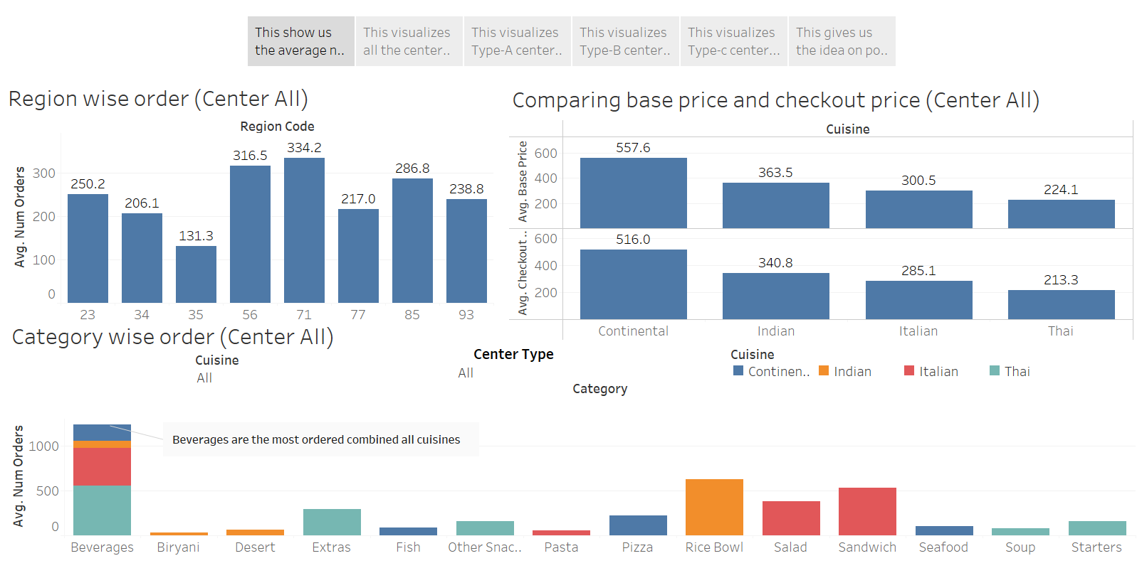

Slide 3
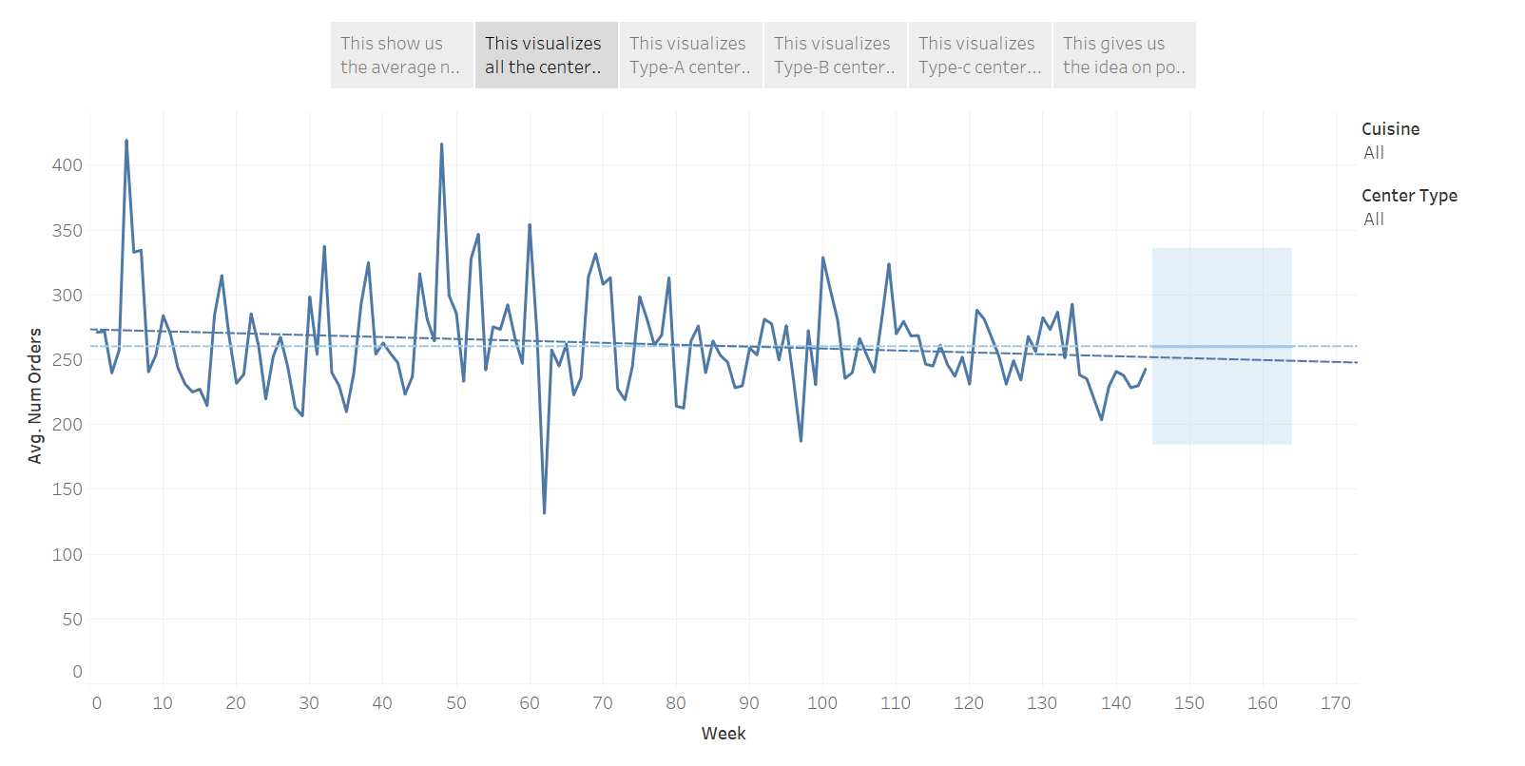

Slide 4
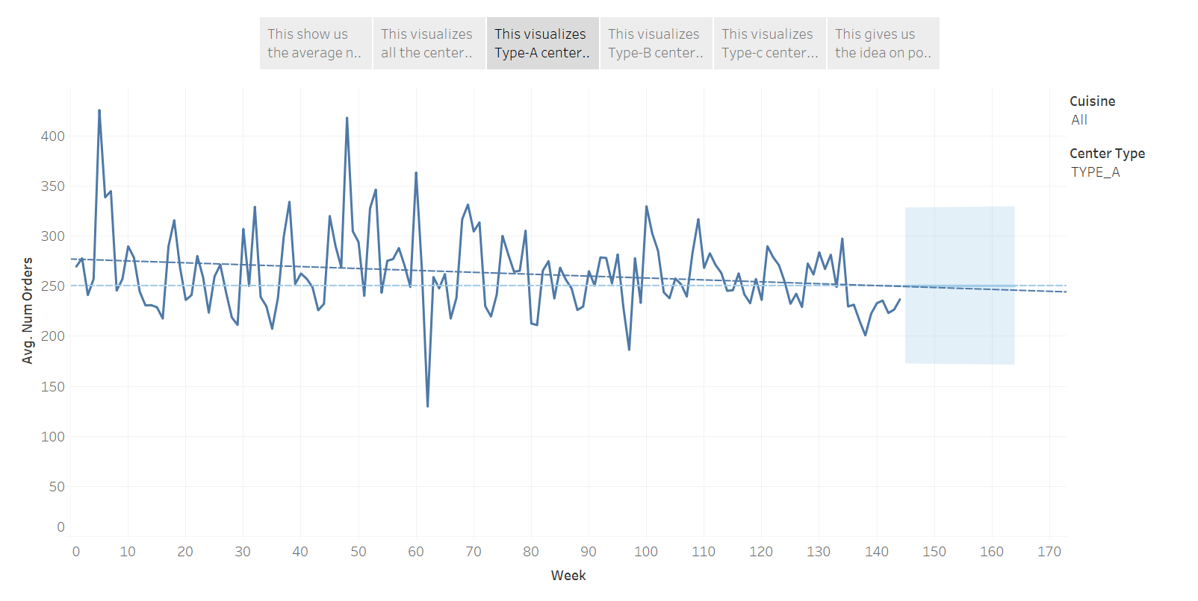

Slide 5
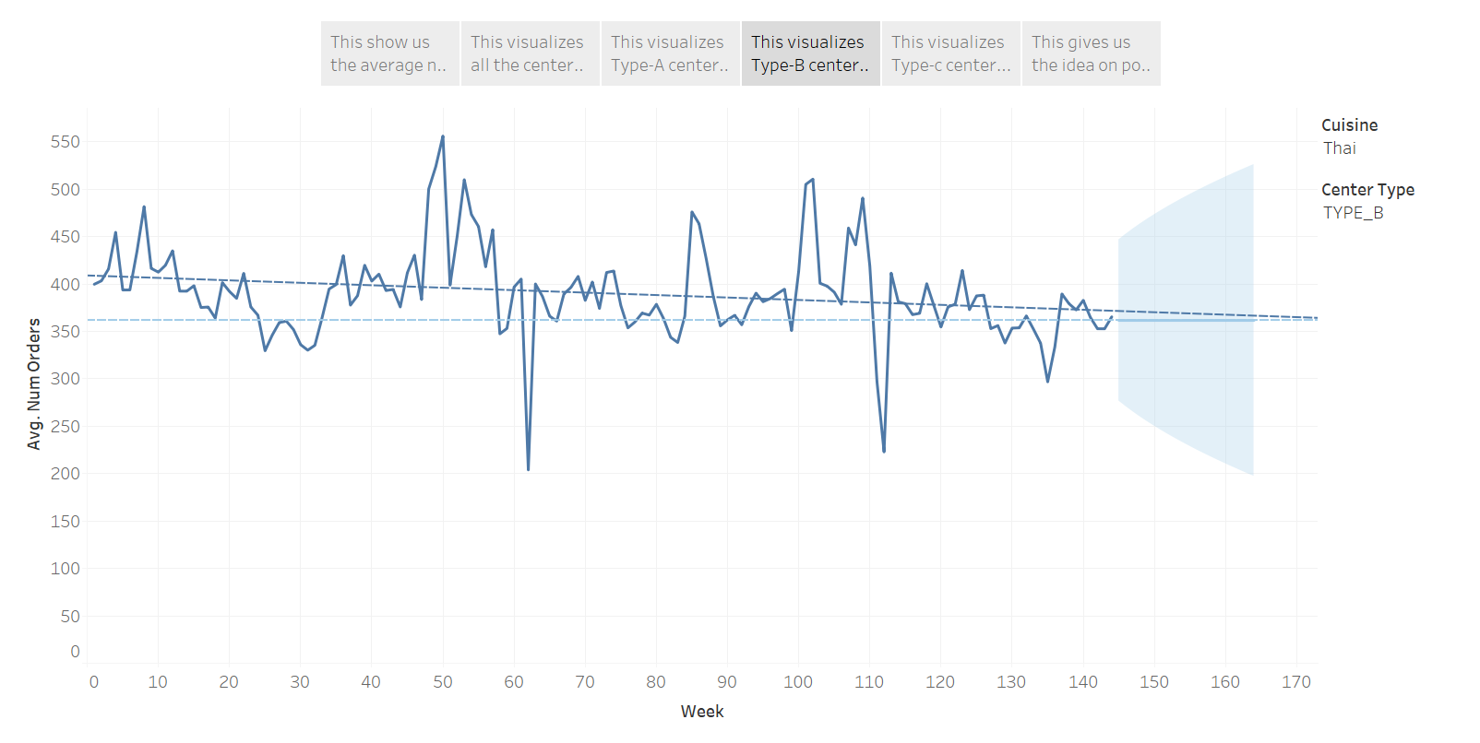

Slide 6
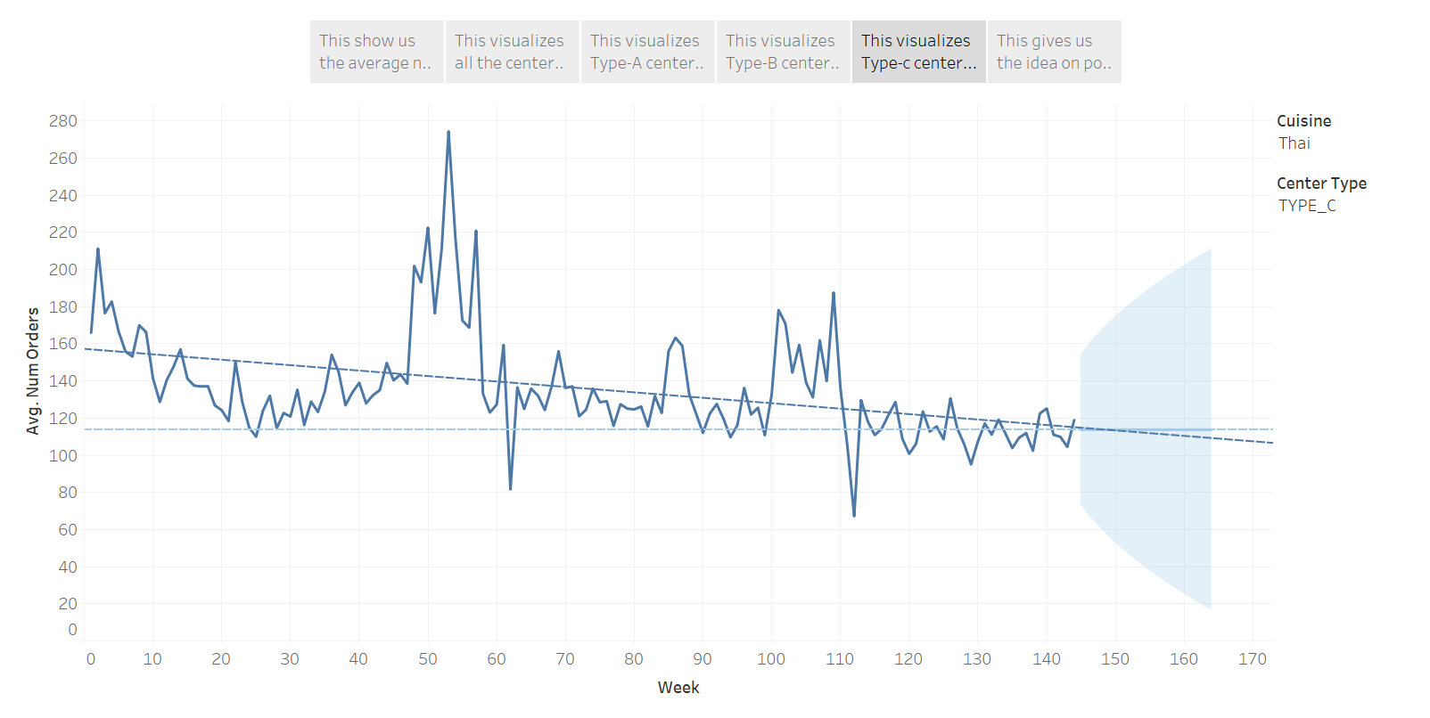

Slide 7
